Slide 1
Middleware , design pattens e DTO
Gabriel Mina

Slide 2
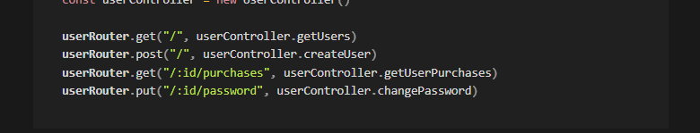

Slide 3
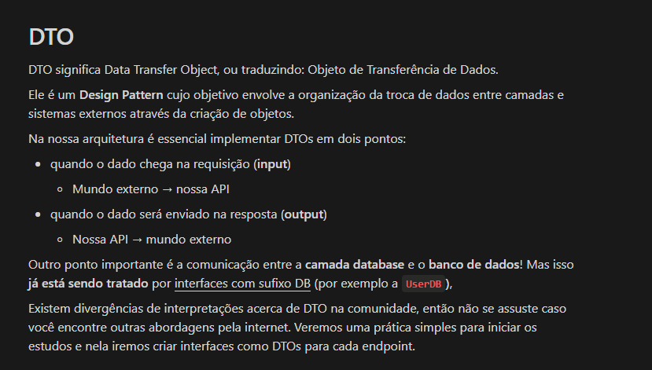

Slide 4
